Slide 1
CHAPTER 1
FUNCTIONS AND MODELS

Slide 2
CONTENTS
1.1 Four ways to represent a function
1.2 Model and Curve Fitting
1.3 New Functions from Old Functions
1.4 Graphing Calculators and Computers
1.5 Exponential Functions
1.6 Inverse Functions and Logarithmic Functions
1.7 Parametric Curves

Slide 3
1.2 MODEL & CURVE FITTING
1.2.1 Linear models
1.2.2 Polynomials
1.2.3 Power functions
1.2.4 Rational functions
1.2.5 Algebraic functions
1.2.6. Trigonometric functions
1.2.7 Exponential functions
1.2.8 Logarithmic functions
1.2.9 Transcendental functions

Slide 4
A mathematical model is a description (by functions, or equations) a real world phenomenon
The purpose of the model is to understand the phenomenon and predict about future behavior
The real world phenomenon may be:
The size of a population
The demand for a product
The speed of a falling object
The concentration of a product in a chemical reaction

Slide 5
A mathematical model is an idealization. It simplifies reality enough to permit mathematical calculations but accurate enough to provide valuable conclusions
Real world problem
formulate
Mathematical model
test
solve
Real world prediction
Mathematical conclusion
interpret

Slide 6
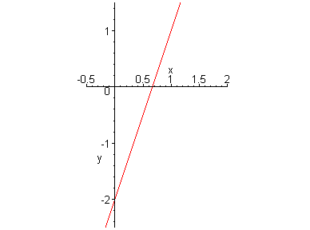
1.2.1 Linear Models
Linear functions grow at a constant rate
x | f(x)=3x-2
1.0 | 1.0
1.1 | 1.3
1.2 | 1.6
1.3 | 1.9
1.4 | 2.2
1.5 | 2.5
slope=3 y-intercept=-2

Slide 7
Example. On the ground (h=0): temperature T = 20º C, and at the height h=1km: T= 10º C
(a) Find the expression of T assuming that T satisfied the linear model
Solution:
Since T satifies the linear model, we have:
T = mh + b
Hence 20 = m . 0 + b ⇒ b = 20
And 10 = m + 20 ⇒ m = -10
Therefore T = -10h + 20

Slide 8

The graph is a line with slope m = -10ºC/km, and y-intercept 20.
The slope m is the rate of change of temperature with respect to height

Slide 9
(c) Temperature at height 2.5 km
With h = 2.5 km we have:
T = -10(2.5) + 20 = -5ºC

Slide 10

Example 2: find a model for the average CO₂ level in the atmosphere given by the following table
Year | CO₂(in ppm)
1980 | 338.5
1982 | 341.0
1984 | 344.3
1986 | 347.0
1988 | 351.3
1990 | 354.0
1992 | 356.3
1994 | 358.9
1996 | 362.7
1998 | 366.7
It seems that the points lie on a line

Slide 11
Using a linear model with the line joining the points (1980,338.5) and (1998,366.7)
The equation of the line is:
C = 1.56667t-2763.51

Slide 12

Using the linear regression procedure we get the best fit
The equation of the line is:
C = 1.543333t-2717.62

Slide 13
The equation of the line by linear regression:
C = 1.543333t-2717.62
By interpolation:
C(1987)= 1.543333x1987 – 2717.62 ≈ 348.98
By extrapolation (to predict the future):
C(2010) = 1.543333x2010 – 2717.62 ≈ 384.48
When will CO2 level exceed 400ppm?
1.543333t – 2717.62 > 400 ⇒ t > 2020.06

Slide 14
1.2.2 Polynomials
A function P(x) is a polynomial if:
P(x)=a_{n}x^{n} + a_{n–1} x^{n–1} + … + a₁x+ a₀
a₀, a₁, …, a_{n} are coefficients of P
If the leading coefficient a_{n} ≠ 0 then P is of degree n
A polynomial of degree 1 is a linear function
A polynomial of degree 2 is a quadratic function

Slide 15
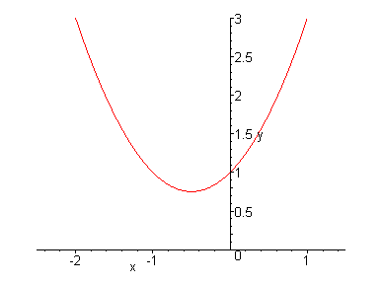
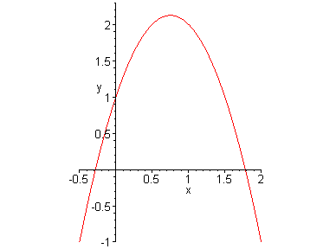
The graph of a quadratic polynomial P(x)=ax²+bx+c is a parabola opening upward if a > 0,
and downward if a < 0
y = x²+x+1
y = –2 x²+3x+1

Slide 16
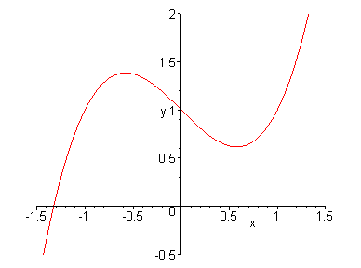
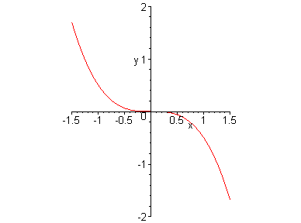
Some of the basic forms for the graph of a cubic polynomial P(x)=ax³+bx²+cx+d
y = x³ – x +1
y = –x³

Slide 17
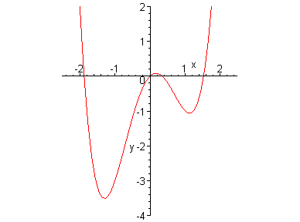
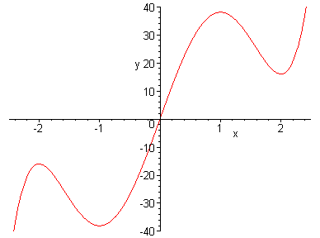
The graph of polynomials of degree 4 and 5 may look like
y = x⁴ –3x²+x
y = 3x⁵–25x³ + 60x

Slide 18

Example: a ball dropped from 450m above the ground. The height h is recorded at 1-second intervals in the table.
Time (second) | Height (meter)
0 | 450
1 | 445
2 | 431
3 | 408
4 | 375
5 | 332
6 | 279
7 | 216
8 | 143
9 | 61
The scatter graph of h(t)

Slide 19

It looks as if the data points lie on a parabola. Using quadratic model we obtain the polynomial:
h = 496.36 + 0.96t – 4,90t²
The ball hit the ground at time t given by:
496.36 + 0.96t – 4,90t² = 0
t ≈ 9.67 seconds

Slide 20
1.2.3 Power functions
The function y=xª , where a is a constant is called a power function
(i) When a=n, a positive integer, the graph of f is similar to the parabola y=x² if n is even and similar to the graph of y=x³ if n is odd
However as n increases, the graph becomes flatter near 0 and steeper when |x| ≥ 1

Slide 21
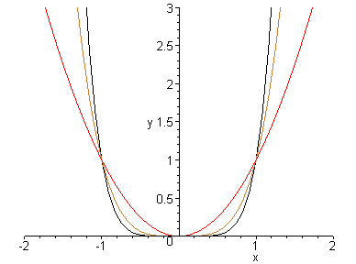
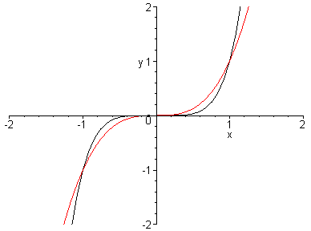
The graphs of x², x⁴, x⁶ on the left
and those of x³, x⁵ on the right

Slide 22
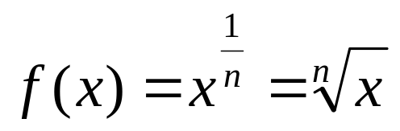
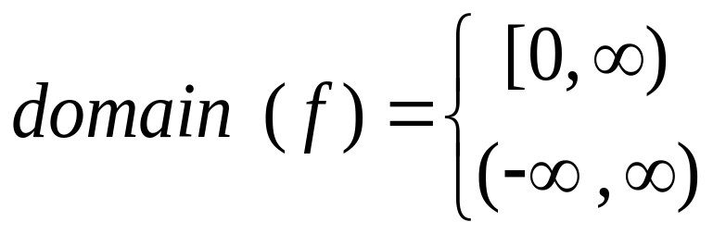
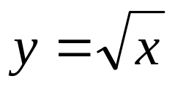
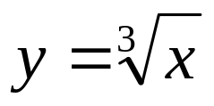
1.2.3 Power functions
(ii) a=1/n, where n is a positive integer
Then is called a root function
if n is even
if n is odd
The graph of f is similar to that of if n is even and similar to that of if n is odd

Slide 23
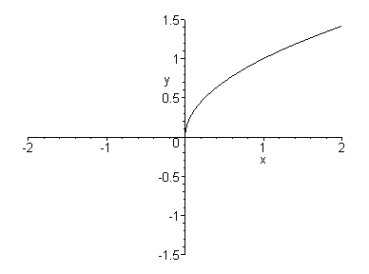
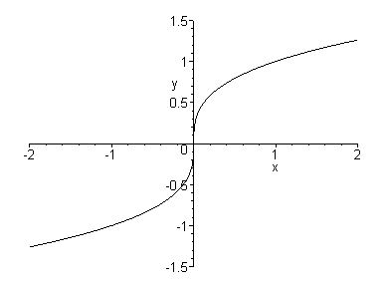
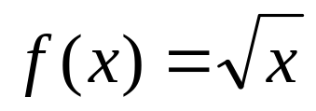
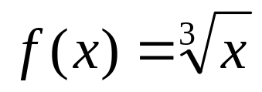
(1,1)
(1,1)

Slide 24
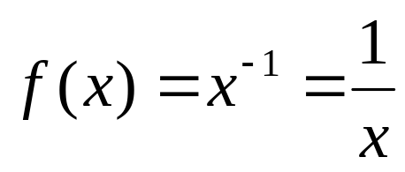
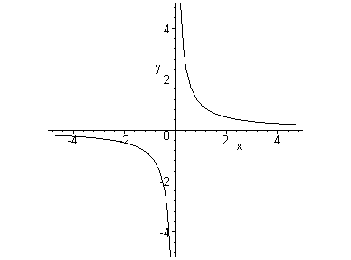
(iii) When a=–1 , is the reciprocal function
The graph is a hyperbola with the coordinate axes as its asymptotes

Slide 25
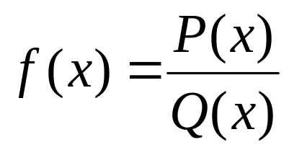
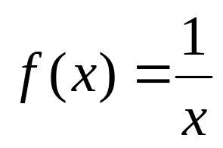
1.2.4 Rational functions
A rational function is the ratio of two polynomials:
Where P and Q are polynomials. The domain of f consists of all real number x such that Q(x) ≠ 0.
is a rational function whose domain is
{x/x ≠ 0}

Slide 26
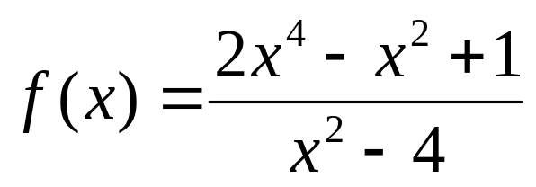
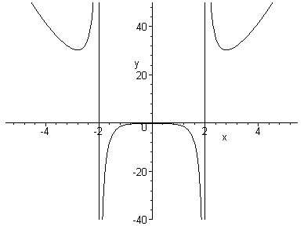
Domain(f)={x/ x ≠ ±2}

Slide 27
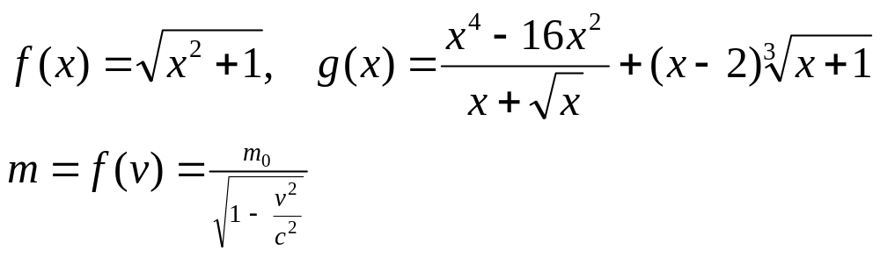
1.2.5 Algebraic functions
A function f is an algebraic function if it can be constructed using algebraic operations (+, -, ., /, √) starting with polynomials.
Example: rational functions and some others

Slide 28
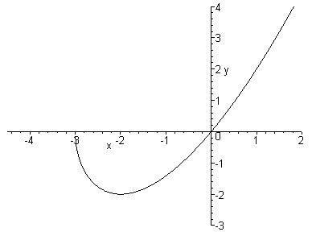
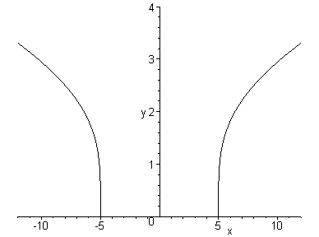
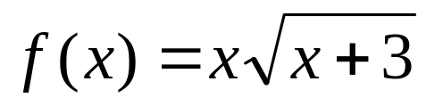
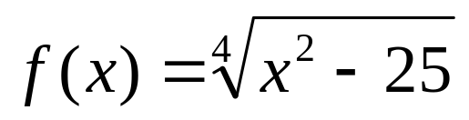
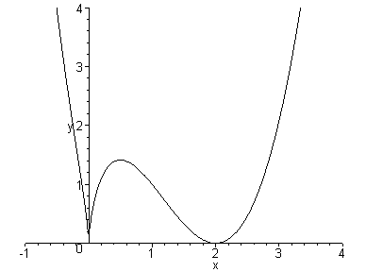
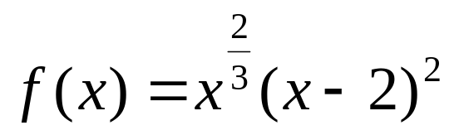

Slide 29
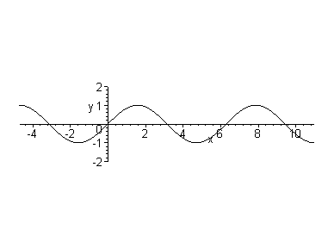
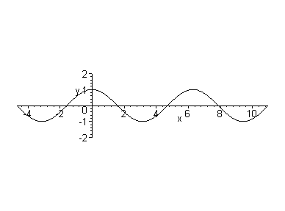
1.2.6. Trigonometric functions
f(x)=sinx
g(x)=cosx
sinx and cosx are periodic functions with period 2π : sin(x + 2 π) = sinx, cos(x + 2 π) = cosx, for every x in R
The domains of sinx and cosx are R, and their ranges are [-1,1]

Slide 30
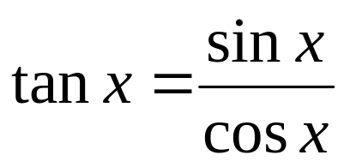
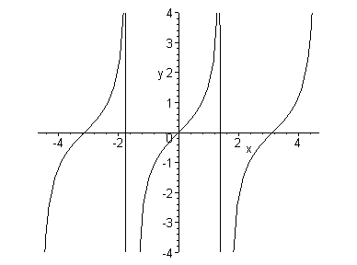
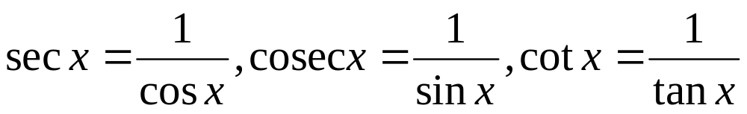
The function is periodic with
period π : tan(x + π) = tanx
The functions cosecant, secant, cotangent are the reciprocal of the sine, cosine, tangent functions

Slide 31
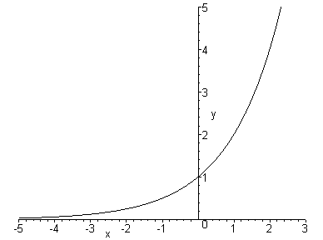
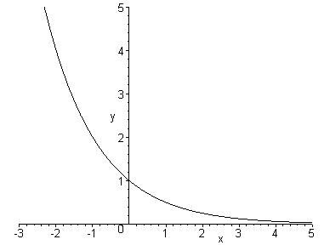
1.2.7. Exponential functions
These are functions of the form f(x)=a^{x}, a > 0
y=2^{x}
y=(0.5)^{x}

Slide 32
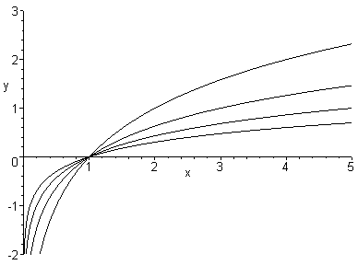
1.2.8. Logarithmic functions
These are functions f(x)=log_{a}x, a > 0. They are inverse of exponential functions
log₂x
log₃x
log₁₀x
log₅x

Slide 33
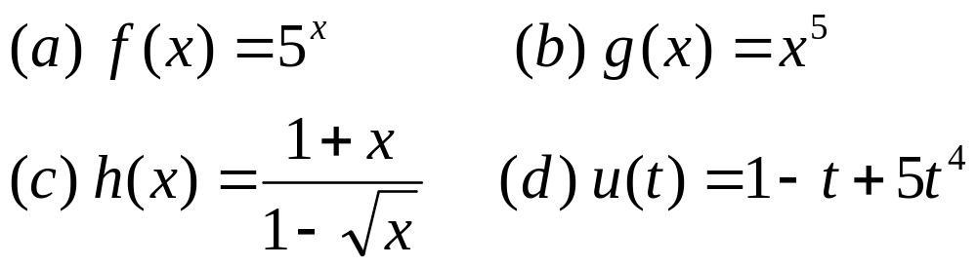
1.2.9. Transcendental functions
These are functions that are not algebraic, such as trigonometric, inverse trigonometric, exponential and logarithmic functions,…
Example: classify the functions:

Slide 34
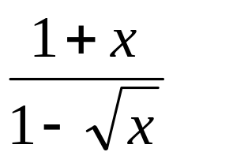
Solution:
f(x) = 5^{x} is an exponential function
(b) g(x) = x⁵ is a power function
(c) h(x) = is an algebraic function
(d) u(t) = 1 – t + 5t⁴ is a polynomial of degree 4

